Slide 1


Cairo University
Faculty of computer and artificial intelligence
Software engineering department
Cosmo Care
Supervised by
Dr. Khaled Wassef
Dr. Rasha ElBanna
Implemented by
20216148 | Mirna Hatem Aly
20216144 | Nadine Hazem Alaa
20216027 | Bassma Khaled Mohamed
20216108 | Neda Osama Ahmed
20206012 | Toqa Ahmed Moataz
Graduation Project
Academic Year 2023-2024
Final Presentation

Slide 2
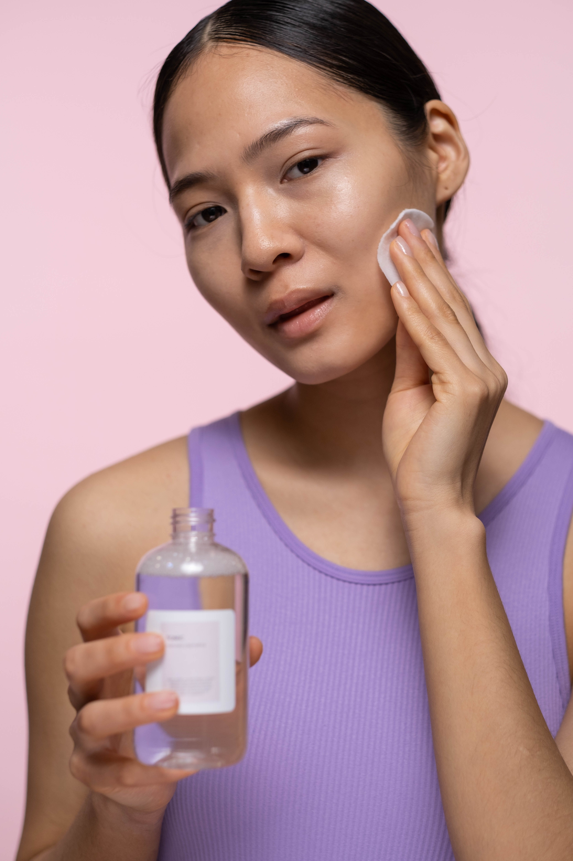
Cosmo Care Application

Slide 3
Cosmo Care Overview
Our mobile application is designed to provide a user-friendly platform with valuable resources and guidance to provide the users with personalized skincare guidance, product recommendations, and help them find out what kind of their skin is and what the specific problem they are suffering from. Also it helps the costumers know more information about any skin care product and provides the suitable product for them.

Slide 4
PROBLEM VS. SOLUTION
01
02
PROBLEM
1. People struggling to identify their specific skin type.
2. lack of centralized, accessible, and personalized skincare guidance and product recommendations.
3. Difficulty for users to navigate and select products that align with their needs and within their budget.
4. Wasting time and money on ineffective products or potentially exacerbate their skin issues.
SOLUTION
An user-friendly application with an AI Skin Type Detection that helps users to identify their skin type and help in finding the appropriate products for them.

Slide 5
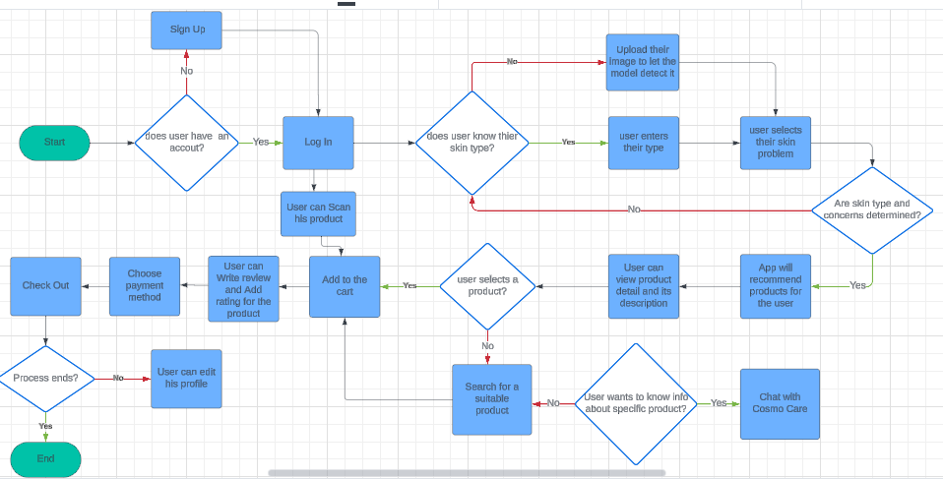
Our specifications
Functional Requirements:

Slide 6
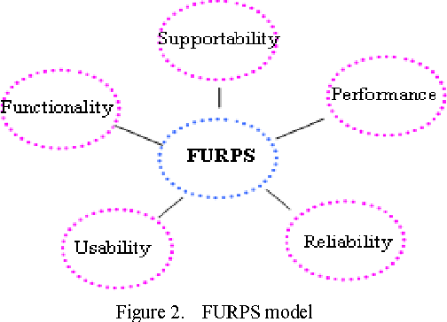
Our specifications
Non-Functional Requirements:

Slide 7
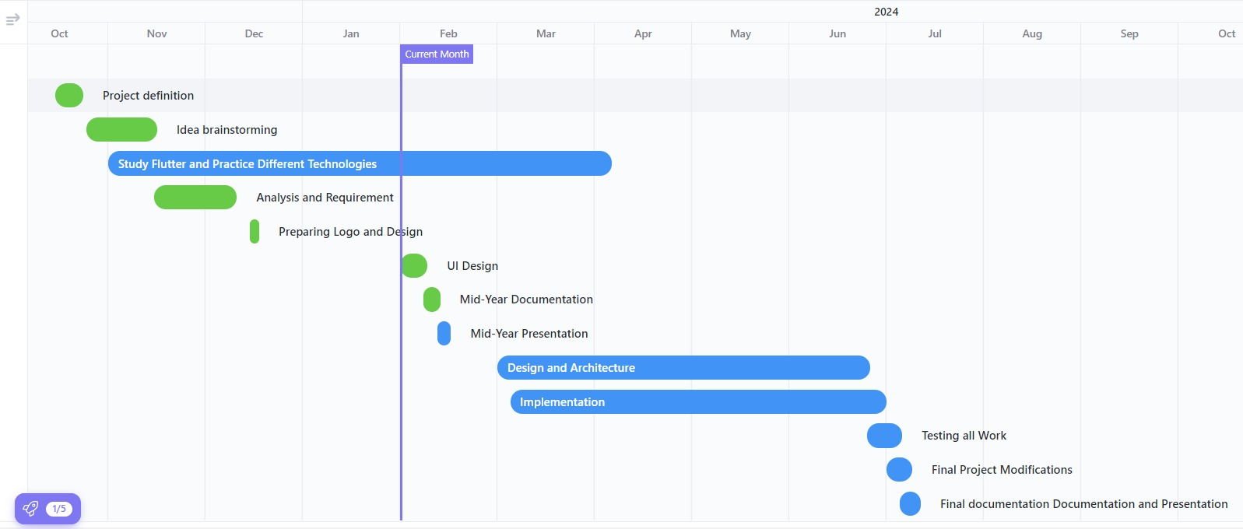
Gantt Chart

Slide 8
MARKET & COMPETITION
01
02
Trove Skin and Charm can be considered the most similar applications to ours
Trove Skin
Mainly focus on comparing the skin health daily and monthly
Having reminders for the morning and night routine
All the information is from the user not detected by an AI
Suitable products (recommended) but the products are not available in markets
Charm
Mainly focus on reminding the users of their skin care routine and giving the user all the info they needed about specific product like how to use it or its ingredients or from where can u buy it
All the information is from the user not detected by an AI

Slide 9

MARKET & COMPETITION
 | Charm | Trove Skin | Cosmo Care
How to use the Products
Products ingredients
Skin Concerns
Overview about the product
AI skin problems detection
Prices of every product
Selfie log to compare the skin progress

Slide 10
MARKET & COMPETITION
 | Charm | Trove Skin | Cosmo Care
Products recommendations
Stash
Shopping cart | ( Direct us to online store to order it like amazon )
Free trial | 7 days | 7 days | 1 month
Skin care tips
Bar code scanning
Morning and night reminders
Rating the skin health

Slide 11
BUSINESS MODEL
Partnerships
Key Resources
- Pharmacists which will provide us with information about the cosmetics and how they are used.
- Dermatologists which will provide the information of when and why the cosmetics are used.
- App of the company supplying the product which will provide us the original price of products
The key resources will be used in development phase is:
- Android studio which is IDE tool with dart language.
- Firebase for the database
- Database will be a key resource which include the data about cosmetic products, skin types, the prices and how to use every product and with which skin type.

Slide 12
BUSINESS MODEL
Customer
relationship
Value Propositions
Our aim is to improve the skin care awareness and to give application treatment for patient’s skin, saving their time and money in achieving skin wellness goals.
- users specify their skin type.
- users can answer questions to help them figure out their skin type (in case they don't know).
- AI is used to recognize skin problems and suggest suitable skin care products within user budget.

Slide 13
BUSINESS MODEL
Revenue
streams
Customer segments
- It targets both females and males but mainly for females +12
- In-App Purchases
- Subscriptions
- Advertising

Slide 14
Architecture & Technologies
System Architecture:
Technologies:
Figma used for UI/UX Designing
Python with Flask used for the machine learning model
Flutter used for building the application UI
Dart used with flutter for backend development
Firebase used for the authentication and data management

Slide 15
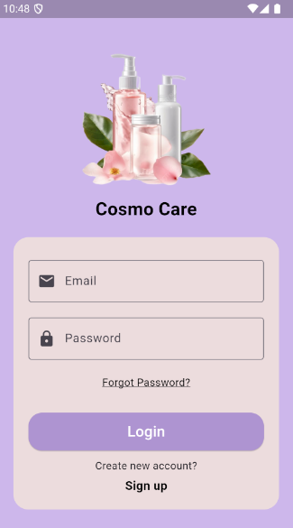
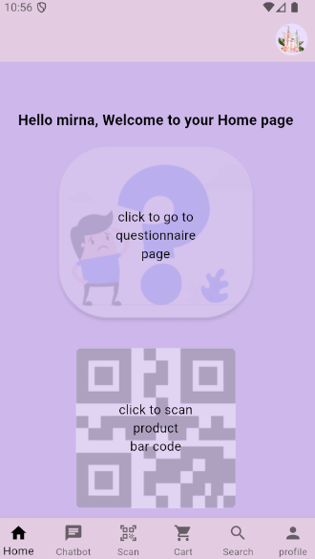
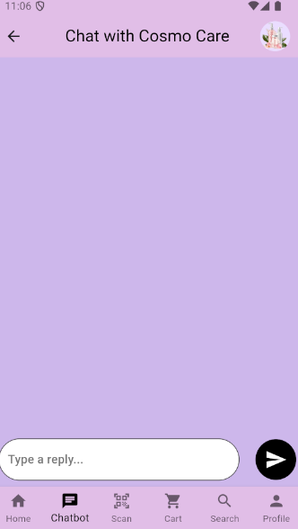
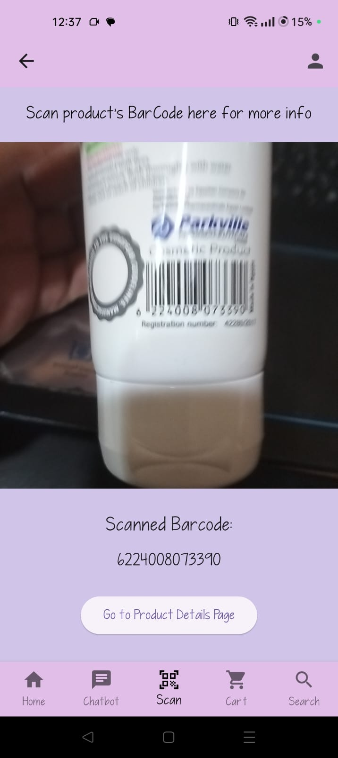
User Interface

Slide 16
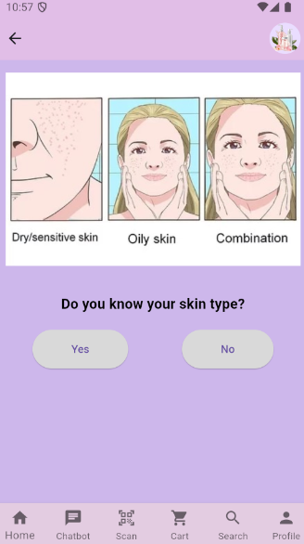
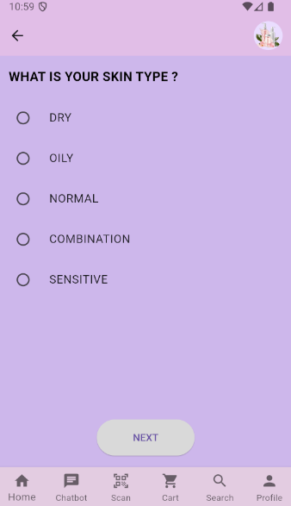
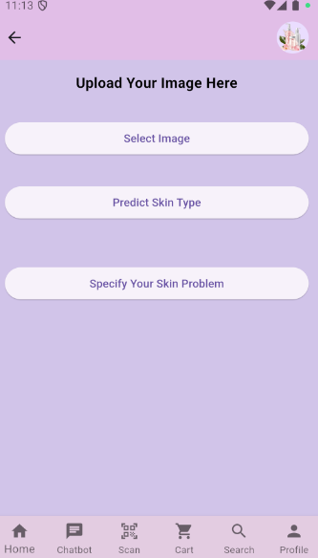
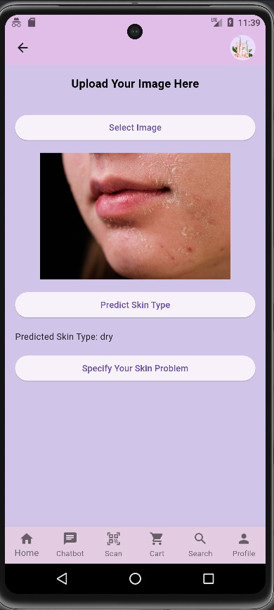
User Interface

Slide 17
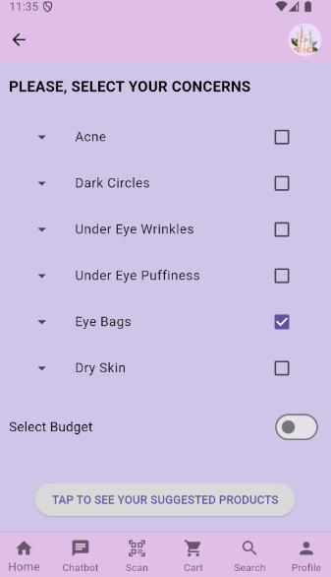
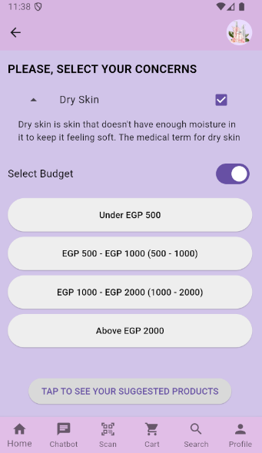
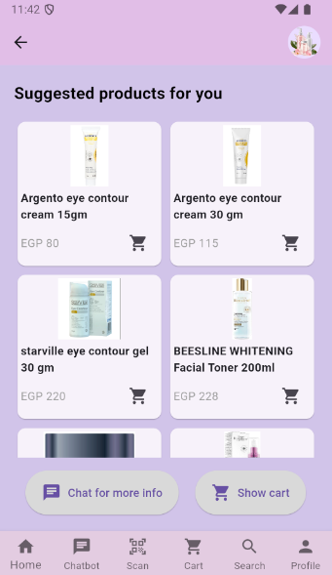
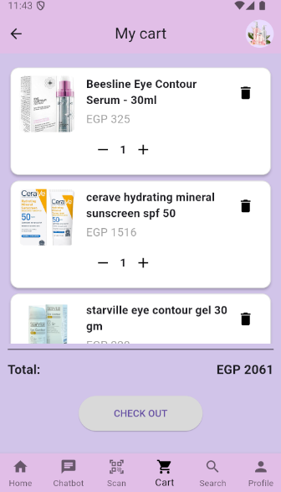
User Interface

Slide 18
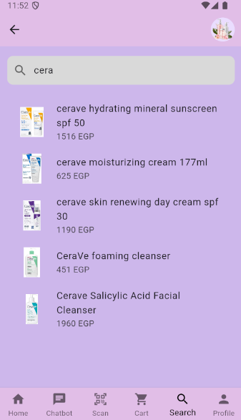
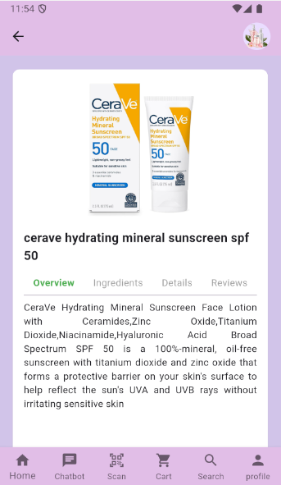
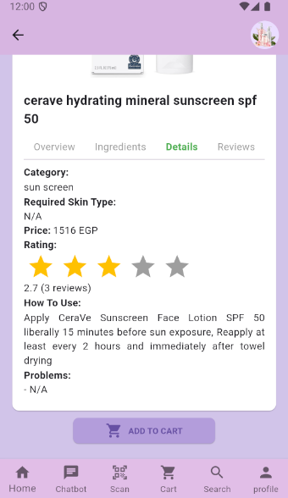
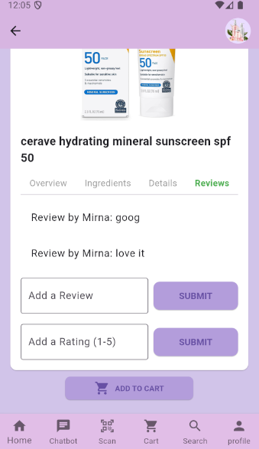
User Interface

Slide 19
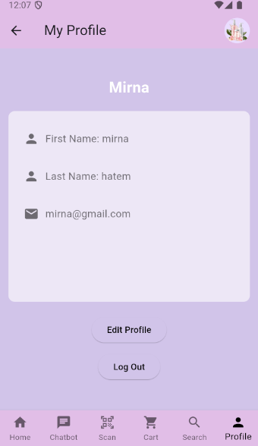
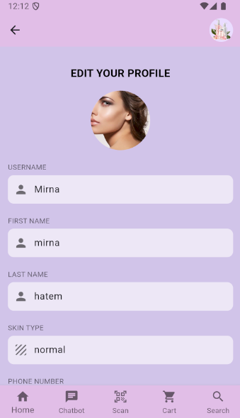
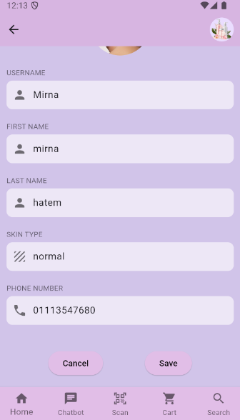
User Interface

Slide 20
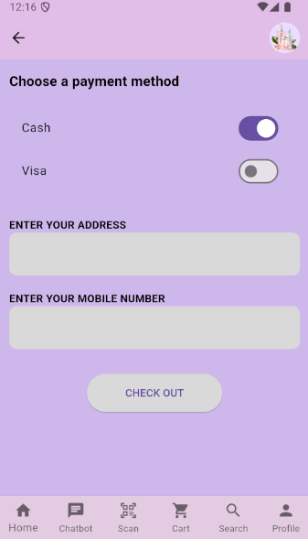
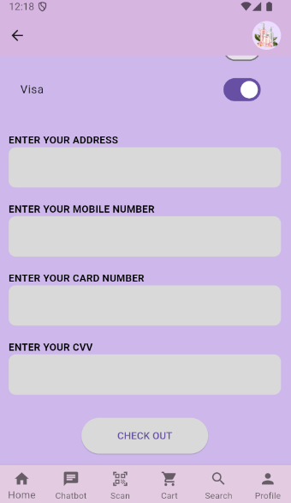
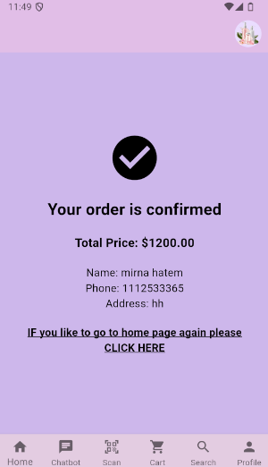
User Interface

Slide 21
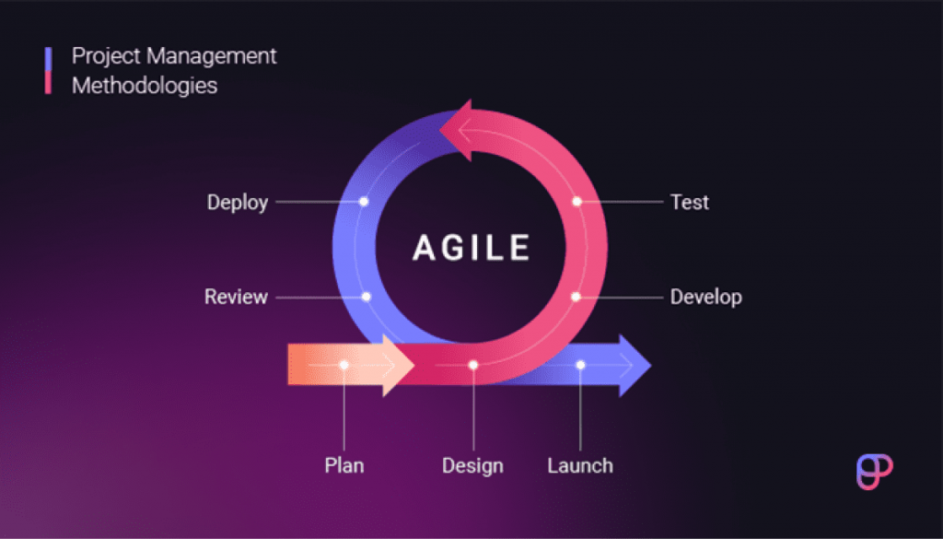
Implementation

Slide 22
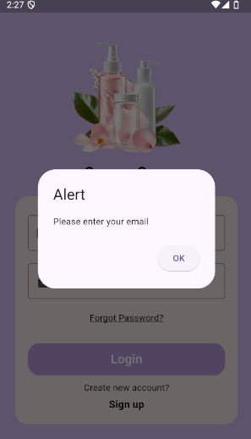
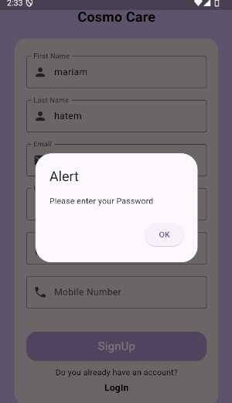
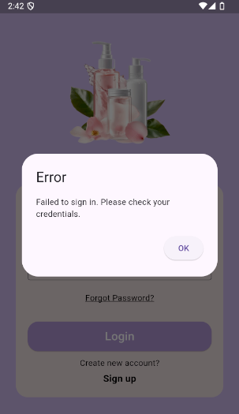
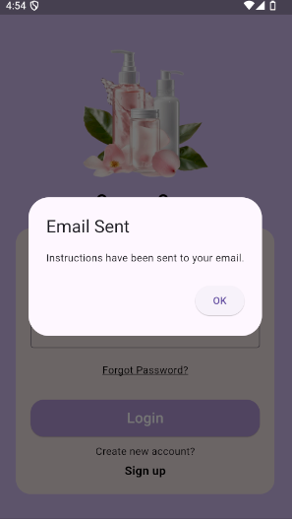
Testing & Validation

Slide 23
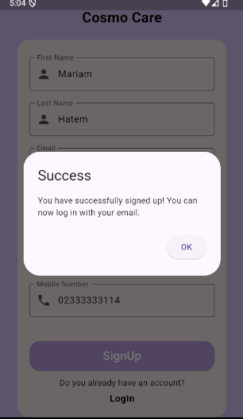
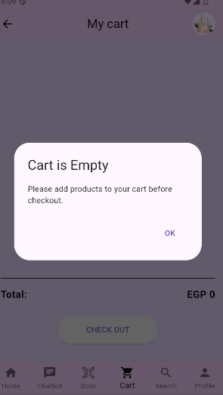
Testing & Validation

Slide 24
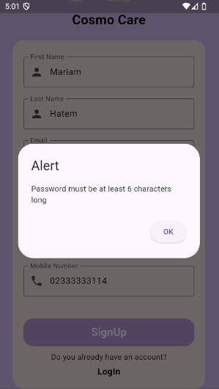
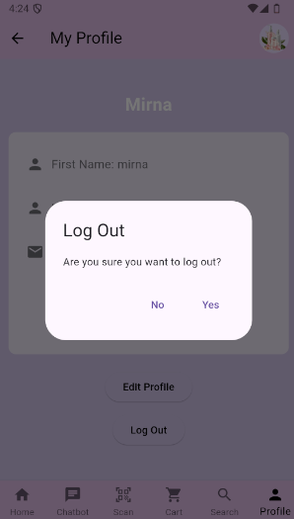
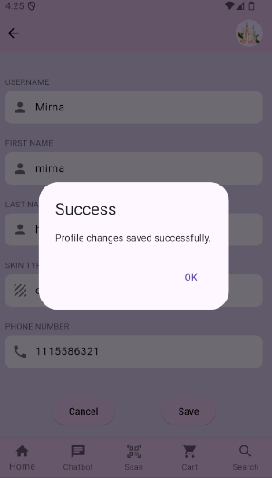
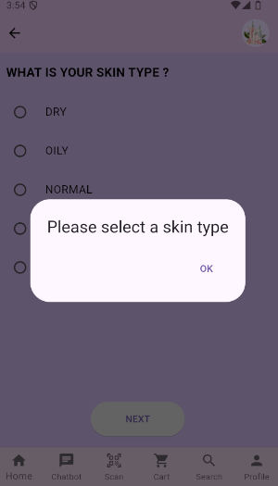
Testing & Validation

Slide 25
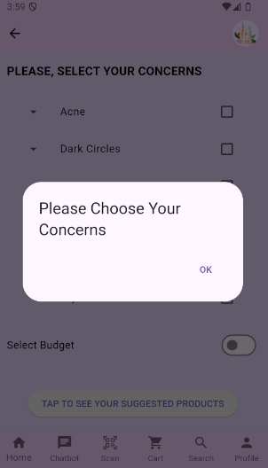
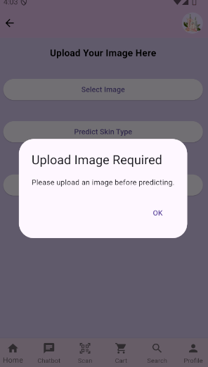
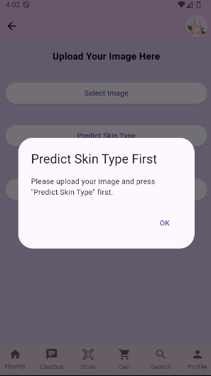
Testing & Validation

Slide 26
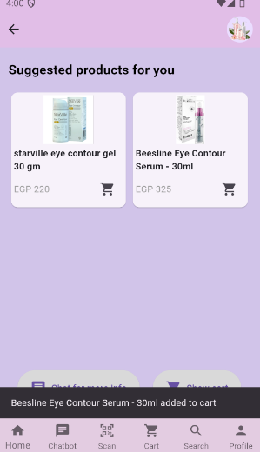
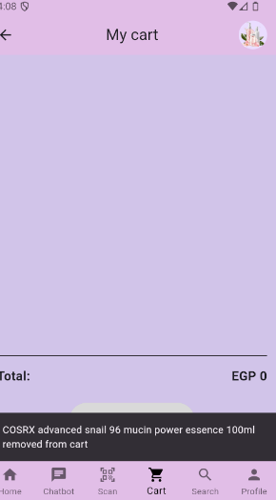
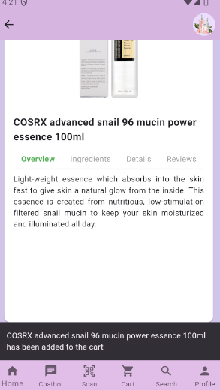
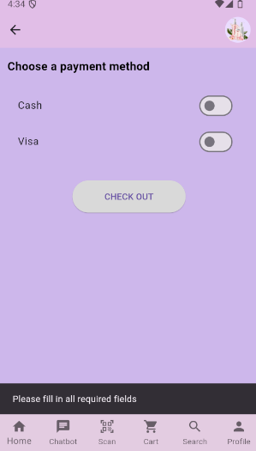
Testing & Validation

Slide 27
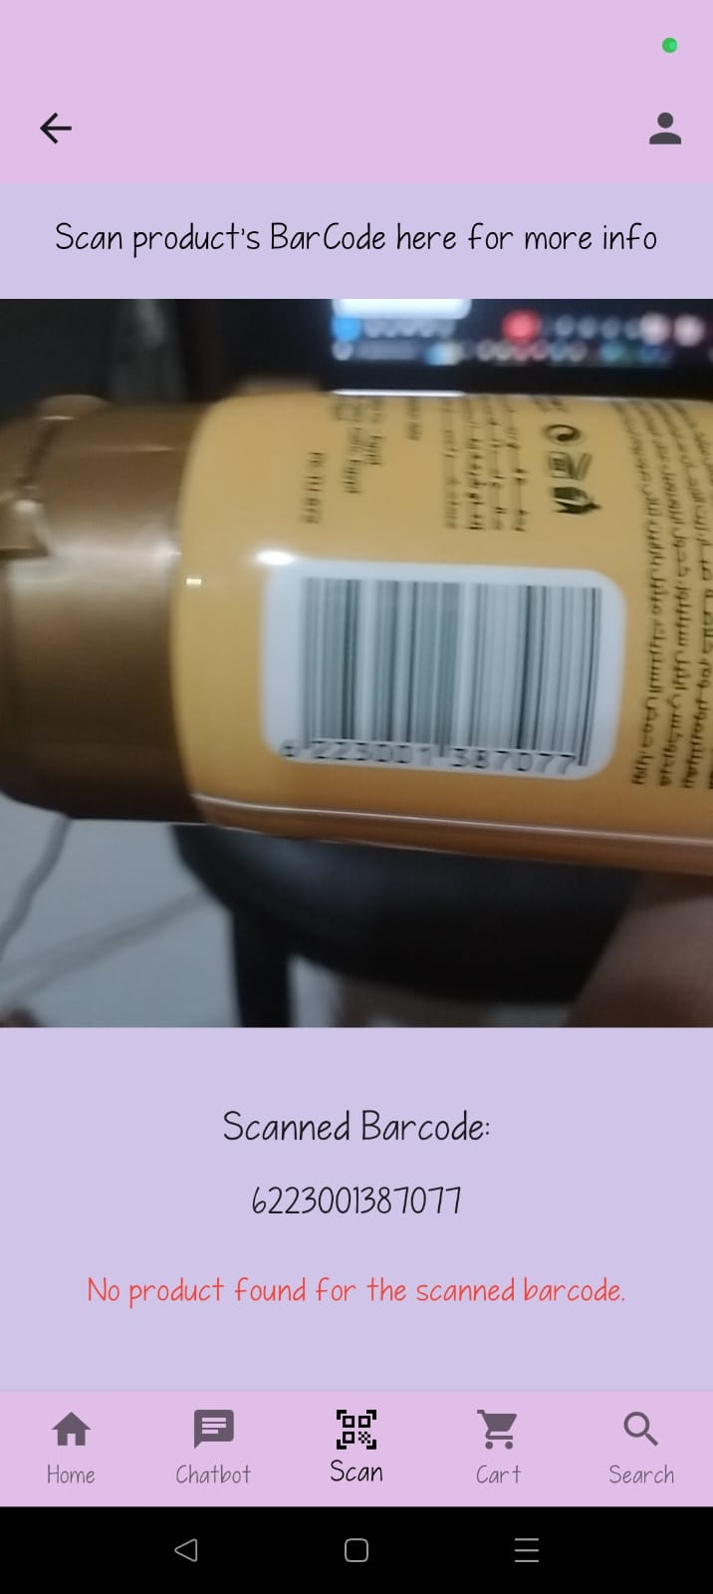
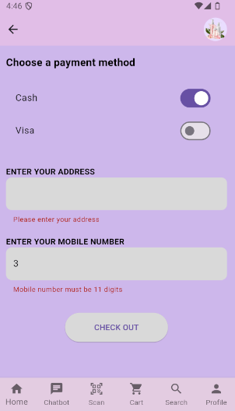
Testing & Validation

Slide 28
EfficientNetV2 Model
the implementation of an EfficientNet-based deep learning model for classifying skin types. The model is trained on a dataset of images labeled as dry, normal, or oily skin. The presentation will cover the model architecture, evaluation metrics, and results.
Dataset Resource : Oily, Dry and Normal Skin Types Dataset | Kaggle
Classes in Dataset :
 | Dry | Normal | Oily
Number of Records | 888 | 1162 | 962

Slide 29
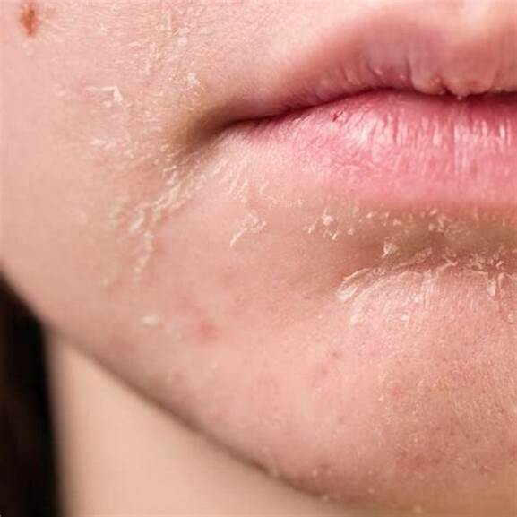
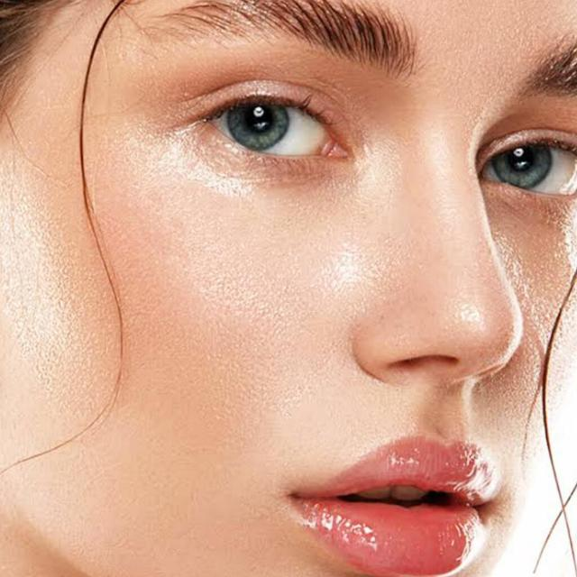
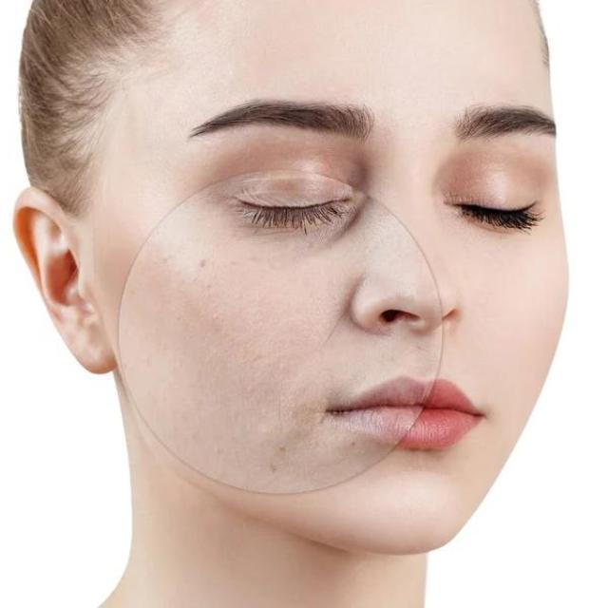
Samples from our Dataset
Dry Skin
Oily Skin
Normal Skin

Slide 30
Model Architecture
Key Components: MBConv Blocks
Depthwise Convolution:
Lightweight operation: Applies separate convolutions to each input channel.
Reduces computational cost.
Expansion Convolution:
1x1 convolution that expands channel dimensions.
Increases model capacity without excessive complexity.
Squeeze-and-Excitation (SE) Block:
Adaptive recalibration of channel-wise features.
Enhances model’s ability to focus on important information.

Slide 31
Data Processing
Resizing (224x224 pixels)
Normalization (Mean and Standard Deviation)
Data Augmentation (Random Vertical Flips)
Evaluation
Test Set Performance: Achieved an accuracy of 87.04% on the test set, demonstrating the model's effectiveness in classifying skin types.

Slide 32
Comparison Between Models
Algorithms | Accuracy
ResNet Baseline | 65%
KNN | 78%
ResNet50 | 80%
EffiecentnetV2 | 87.04%

Slide 33
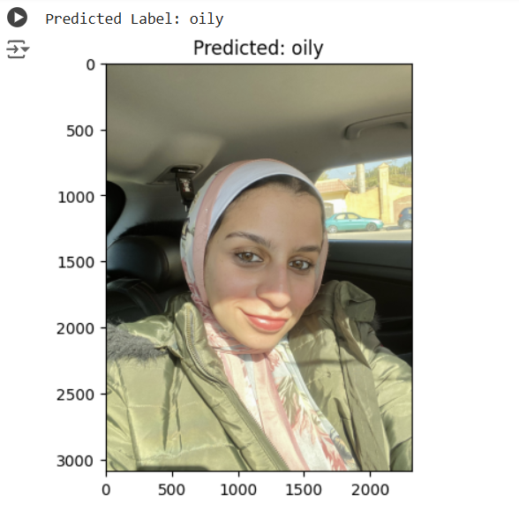
Example Prediction

Slide 34
Conclusion
Summary:
EfficientNet V2 S effectively classifies skin types.
Achieved high accuracy.
Challenges:
- Data preprocessing, model fine-tuning, Chatbot integration with Gemini, Bar code scanning version issue of the mobile scanner dependency, Data types in fire store, Product detail information.

Slide 35
Conclusion
Solutions:
1) Data augmentation.
2) optimal parameter tuning.
3) API handling concerning double/single quotes.
4) Adding and fetching MobileScanner widget in the project with 3.3.1 version.
5) Search for the specific attribute and modify its data type.
6) Manually Information gathering.

Slide 36
Future Work
Future Work in Model:
Explore other model architectures: Consider experimenting with different architectures.
Increase dataset size: Collect more data for better generalization.
Integrate model into application: Deploy the model for real-time skin type classification.
Classify products based on ages.
Concerns Detection and suggestions for suitable products.
Show history of suggested products in search.
Add more skin types like Sensitive and Combination skin.

Slide 37

Live DEMO

Slide 38

THANK YOU FOR YOUR TIMING
ANY QUESTIONS?

